Slide 1

Tip-thrust Rotary Aircraft
Progress Presentation, Presented by Rayde Krüger [24723061]
Photo by Stefan Els
Notes:
Good morning Prof Owen, Dr Gill and fellow students

Slide 2





Contents
Directional Thrust from Tip-thrust Rotary-wing Aircraft
Design
Tip-Thrust Helicopters
Rotor Pitch Control
Roadmap
Modelling the System
Notes:
Obtaining directional thrust from Tip-thrust rotary aircraft.

Slide 3
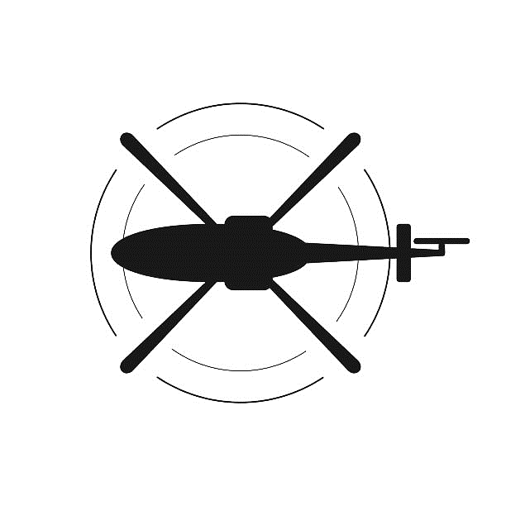
Tip-Thrust Helicopters
Tip-Thrust Helicopters and their Advantages
Blade rotation
Traditional helicopters use an engine, tip-thrust helicopters apply the force to the rotor
No need for a tail rotor, large transmission shafts or complex gearboxes
Higher efficiencies than quadcopters
Blade rotation
Torque
Tail rotor thrust
Tip thrust
Traditional helicopter
Tip-thrust helicopter
Notes:
Helicopters fly by having a large engine in the fuselage which drives the rotor through a transmission shaft and gearbox.
Applies torque to body
Tip-thrust eliminate need
By applying force
on the blade itself which creates the torque to spin the rotor
Many different methods exist to produce this force, but for this project electric motors with propellers will be used

Slide 4
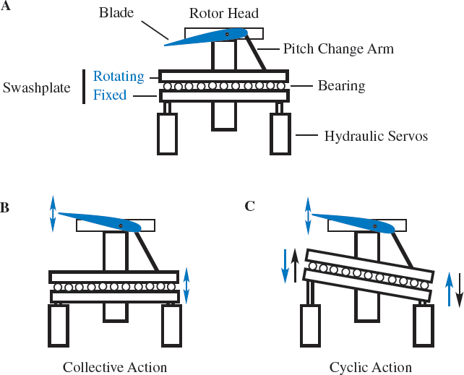
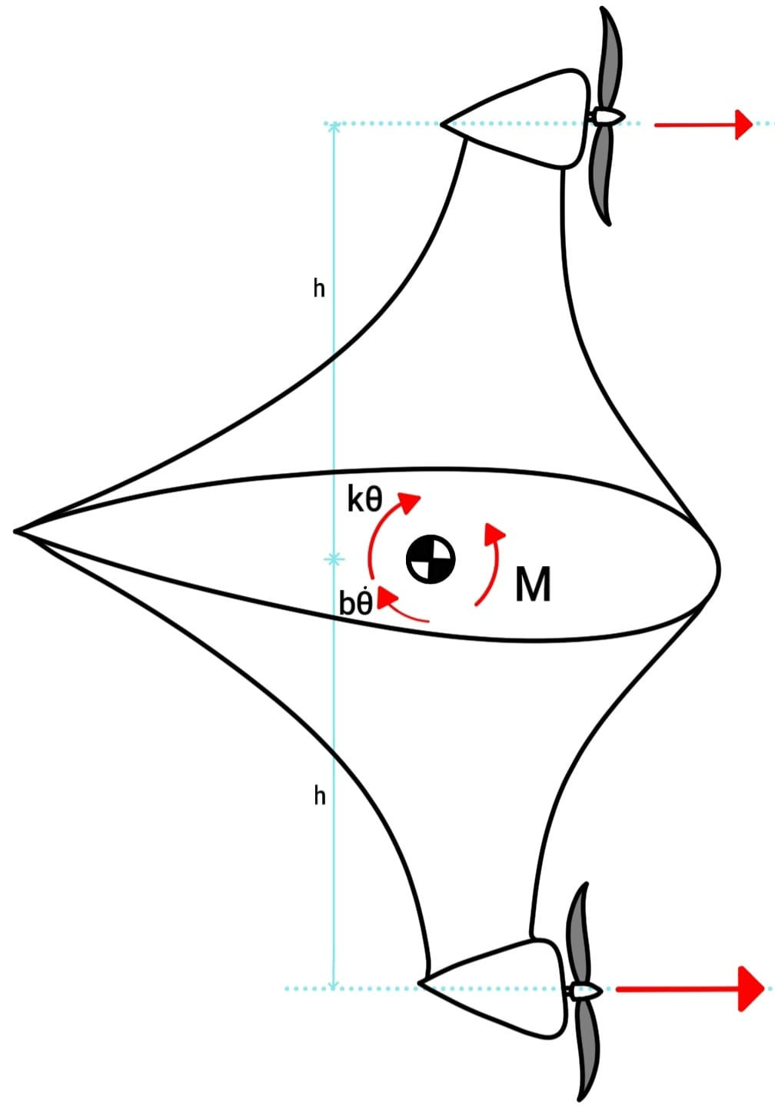
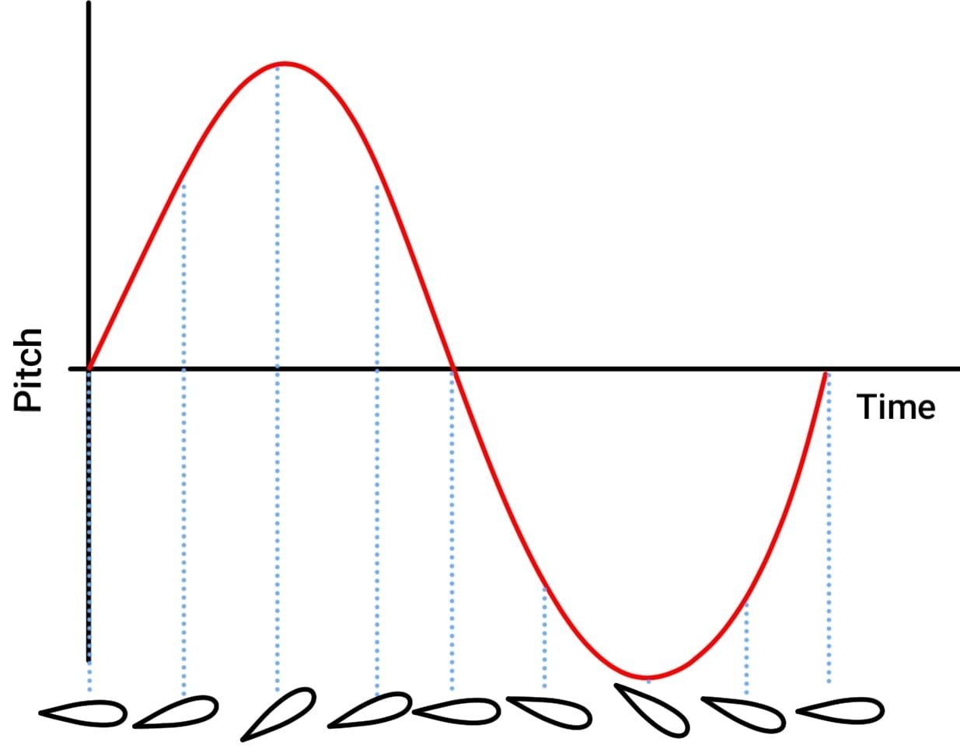
Rotor Pitch Control
Swashplate
Differential Thrust
Moment [Nm]
Time [s]
Swashplates translate mechanical inputs into a change in rotor pitch
Offset thrust thrust creates a moment which changes the pitch of the rotor
Notes:
The second part is to create directional thrust from the rotor.
Swashplate translates mechanical inputs into a change in rotor pitch
Collective action raises/lowers uniformly changes the pitch of the rotor
cyclic action tilts the swashplate the pitch of the rotor vary along its rotation
Creates more lift
Offset the motors to create the a moment to change the pitch which can changed siusiodially to produce the same as the cyclic action
Offset thrust
Sinusodially

Slide 5
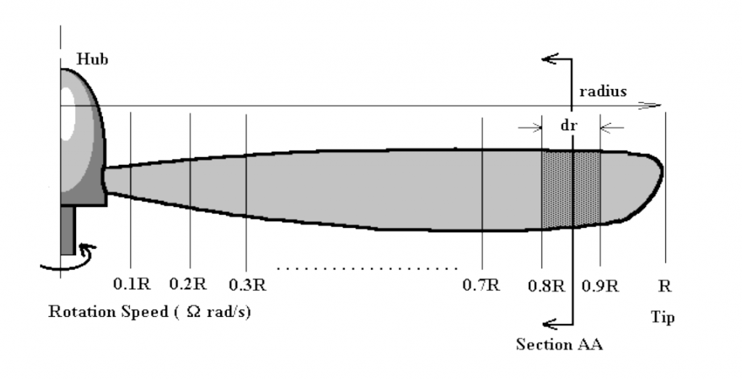
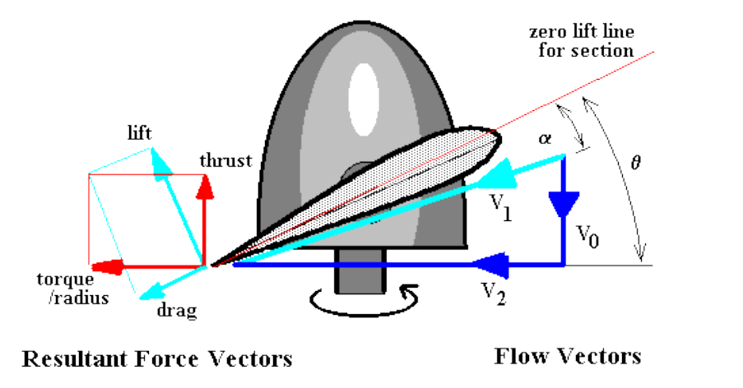
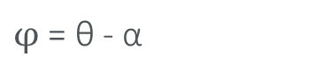
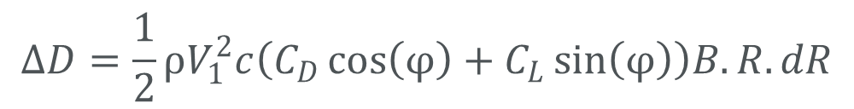
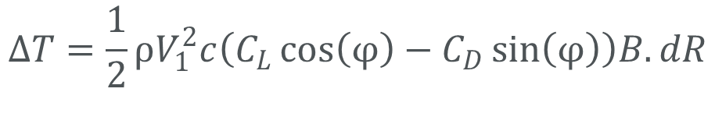
Modelling the System
Blade Element Analysis
Divides the blade into 2D segments and a force balance is applied to each segment
The sum of each segment gives the total thrust and torque produced
Coefficient of lift
Coefficient of drag
$$ΔT=\frac{1}{2}ρV_{1}^{2}c\left(C_{L}\cos\left(φ\right)−C_{D}\sin\left(φ\right)\right)B.dR$$
Blade width
$φ$ = θ - α
Number of blades
$$ΔD=\frac{1}{2}ρV_{1}^{2}c\left(C_{D}\cos\left(φ\right)+C_{L}\sin\left(φ\right)\right)B.R.dR$$
Notes:
The first step was to create a mathematical model of the system
2D segments w/ force balance
Sum gives total thrust and torque
Theta is pitch, alpha is angle of attack.
AOA affects the amount of lift produced and is affected by the incoming air velocity and the blade’s angular velocity.

Slide 6
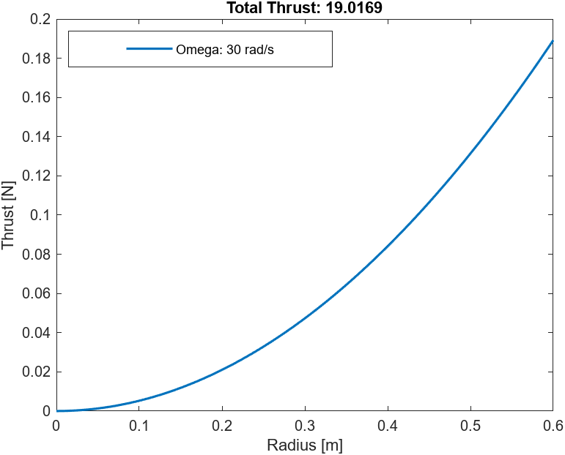
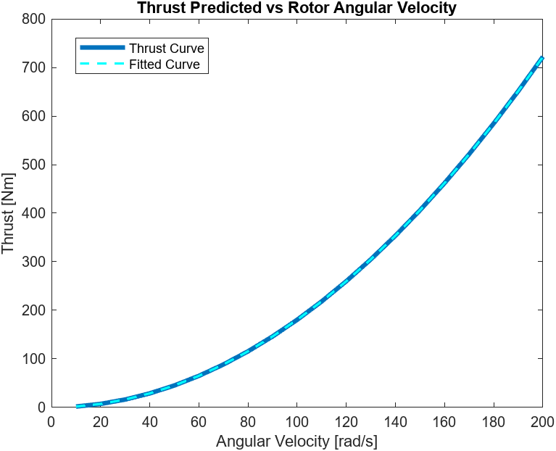

Modelling the System
Modelling the Rotor
Use an iterative approach to estimate the airflow through the rotor
This was repeated for multiple angular velocities and the total thrust was recorded
A curve was fitted to a graph which describes the total thrust vs angular velocity
$$T=0.01805 ω_{Rotor}^{2}$$
Notes:
Using this method, the rotor was analysed.
It was an iterative approach
Gets approximated from the thrust and the thrust is recalculated.
Shown by the graph the amount of thrust increases furthers along the rotor as the radial velocity increases.
As main concern is total thrust, it was recorded for different rotor angular velocities and a curve was fitted to create a simplified model.

Slide 7
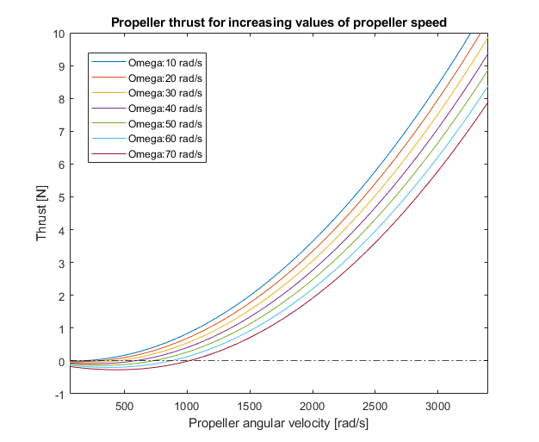
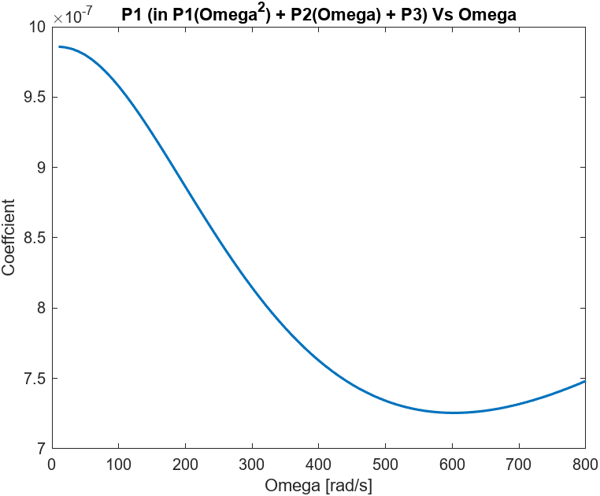
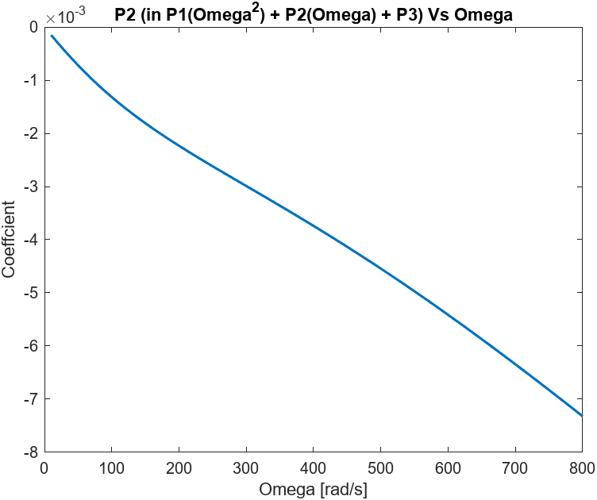
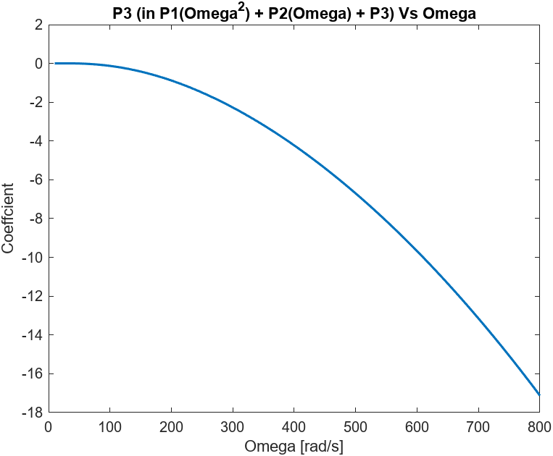

Modelling the System
Modelling the Tip-thrust Propellers
Incoming air speed is due to the angular velocity of the rotor multiplied by the distance the tip thrusts are from the hub
The graphs can all be represented by parabolic equation
$$T_{prop}=P_{1}ω_{prop}^{2}+P_{2}ω_{prop}+P_{3}$$
Notes:
As mentioned previously, the incoming air velocity will affect the amount of thrust produced
For the propellers, the incoming air can be approximated as the angular velocity of the rotor times by the distance from the hub to the motors.
All represented by parabolic equation
Except each will have coefficients which are dependent on the angular velocity.
The solution was to best fit a curve for each coefcient,

Slide 8
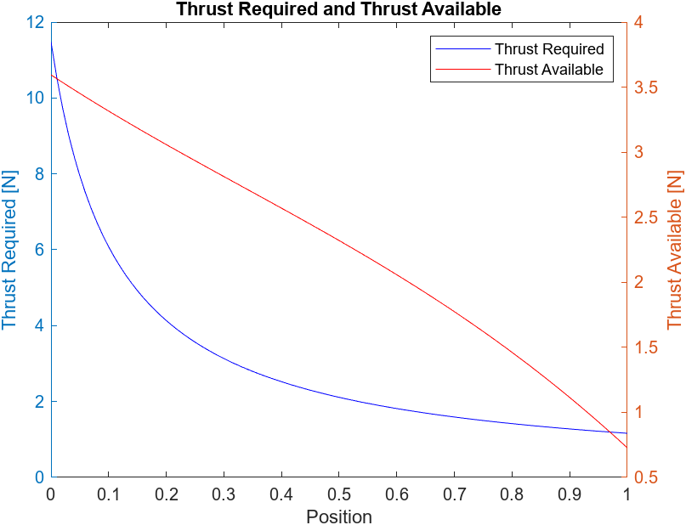
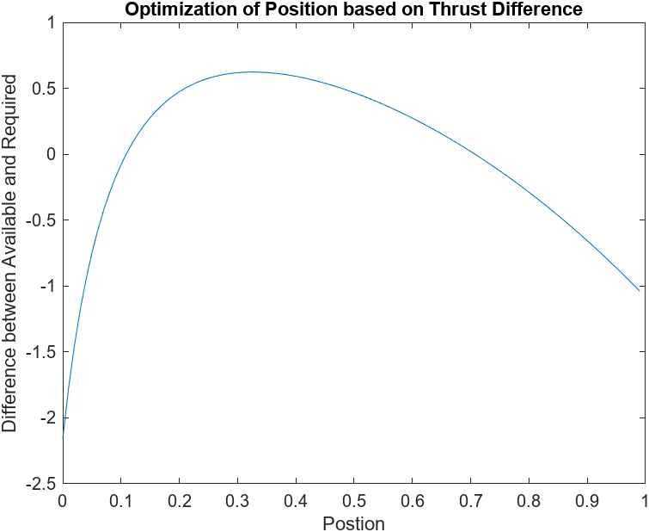
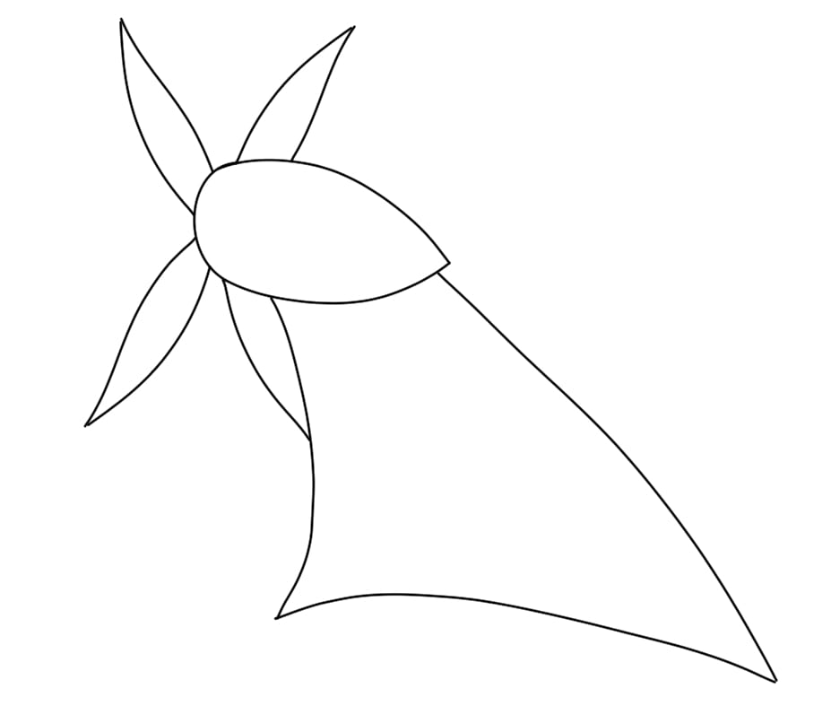
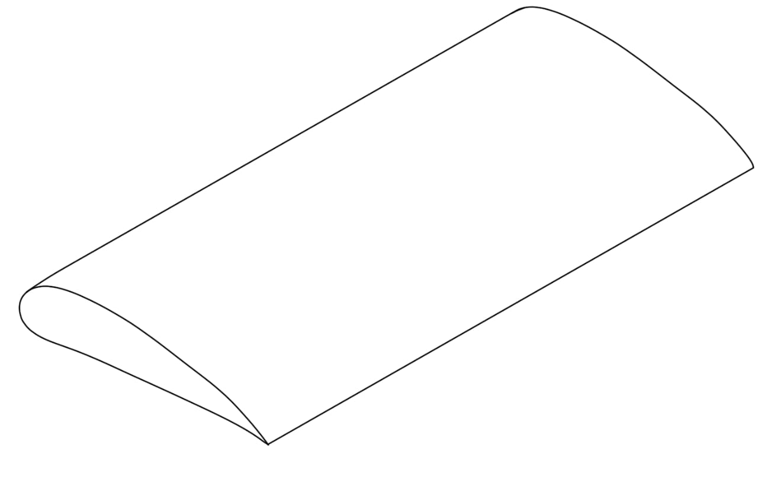
Modelling the System
Optimizing the Thrust Position
Incoming Airspeed
Thrust available decreases as the torque produced increases
32.5 % of the rotor length
Notes:
As the air speed increases the further from the hub, thrust generated by the tip thrust decreases as it moves further along the rotor blade, however maximum torque
Move motors
Increasre thrust, increase thrust required
towards hub

Slide 9
Modelling the System
Optimizing the Thrust Position
Incoming Airspeed
Thrust available decreases as the torque produced increases
32.5 % of the rotor length
Notes:
Increasre thrust, increase thrust required
This relathionship rep by the graph,
Sdtnadadised subtracted
Optimal at 32.5 %

Slide 10
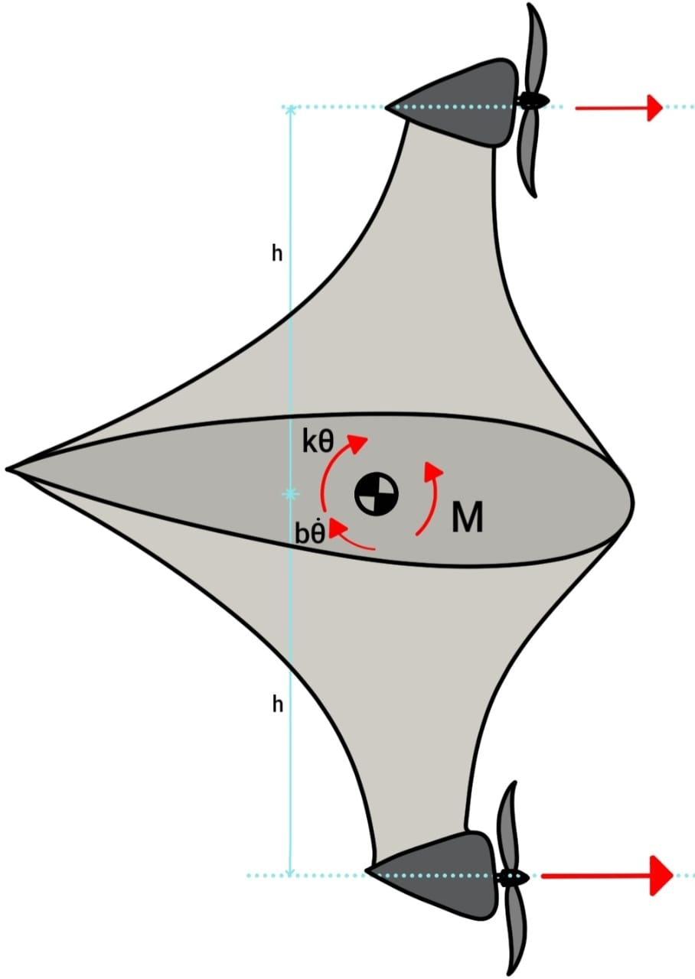
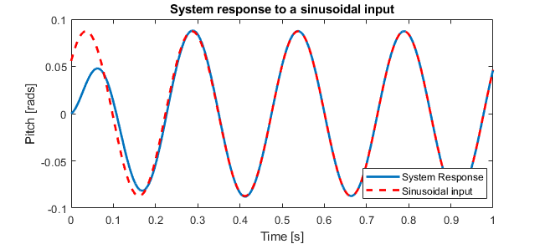
Modelling the System
Pitch Modelling
Mass-spring-dampening model with no artificial dampening
Found the moment required to change the pitch with a step input (collective action) and sinusoidal input (cyclic action)
Smallest when the spring stiffness makes the natural frequency the same as the angular velocity of the rotor
θ
Notes:
Final model mass-spring damping system to model the pitch of the rotor and determine the value of the moment that needs to be applied from the differential thrust
naturally present
Two models were created, one for a step input, which will act like the collective action of the swashplate,
other with a sinusoidal input which will act like the cyclic action
It was found
the spring constant must be chosen, such that the natural frequency will match the frequency of the rotor turning.

Slide 11
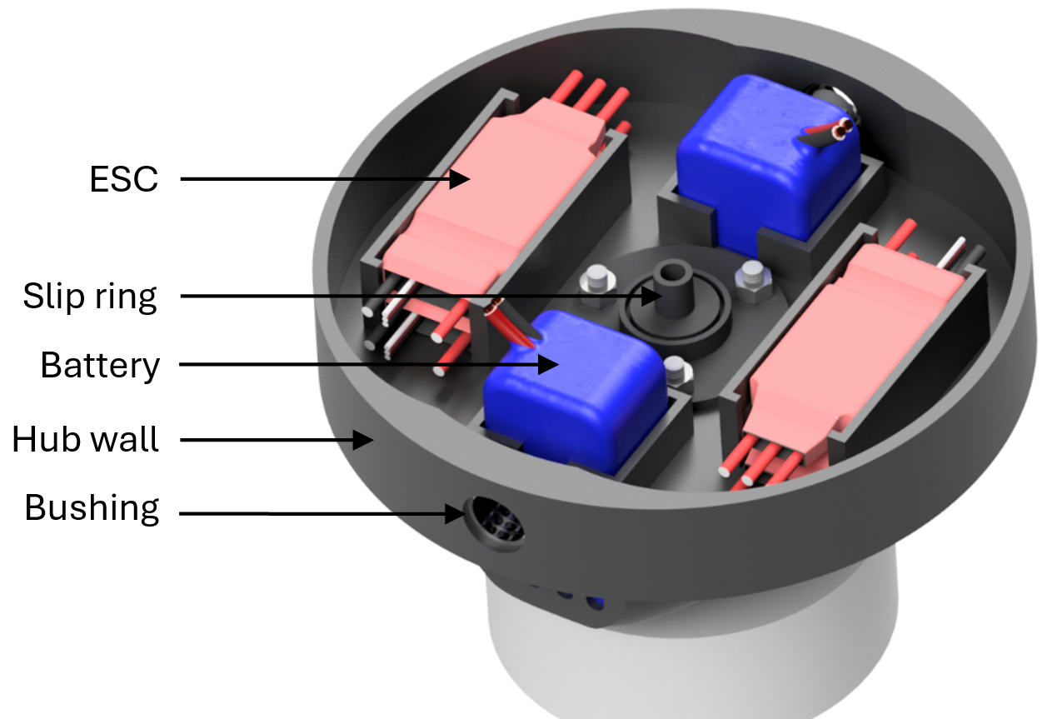
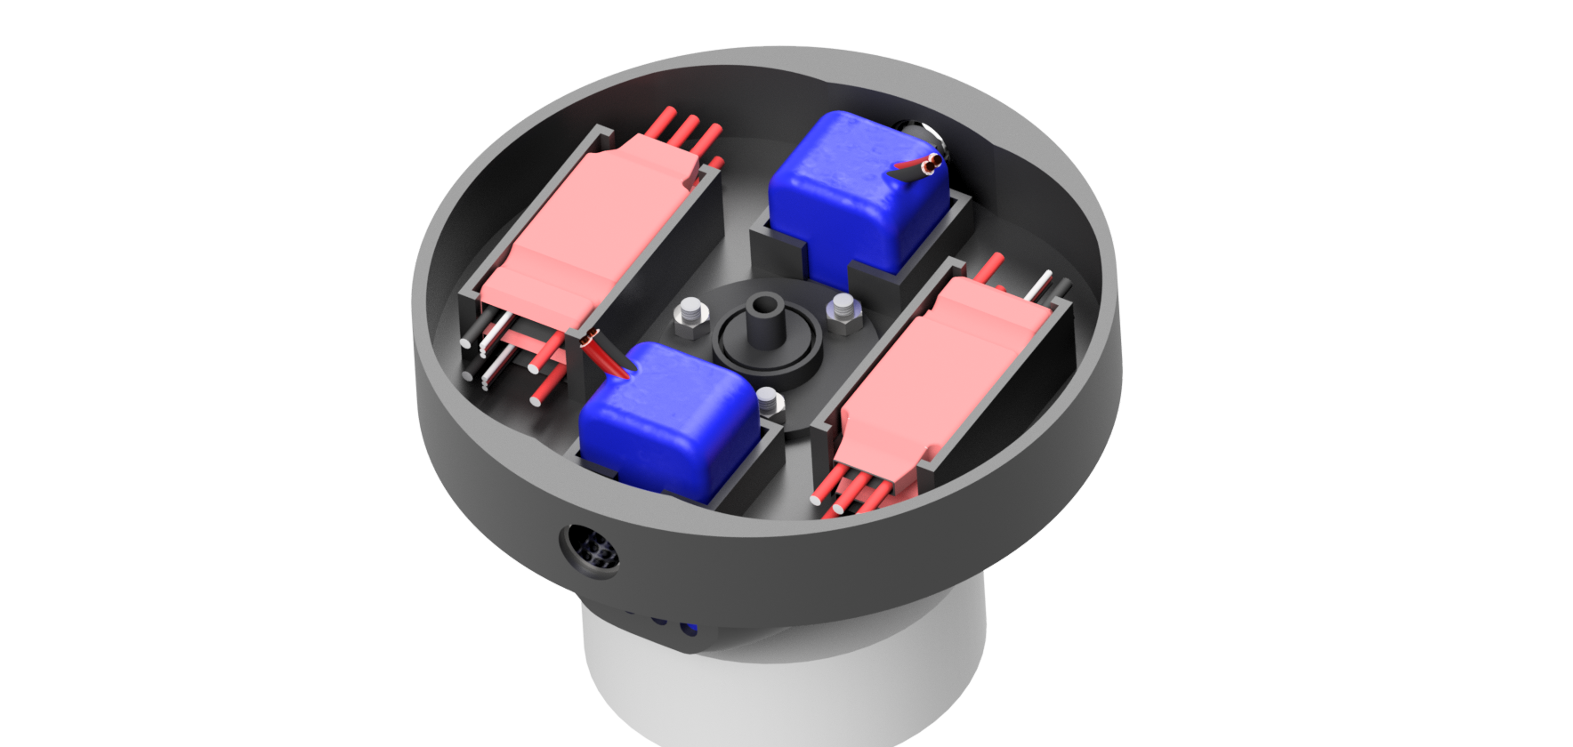
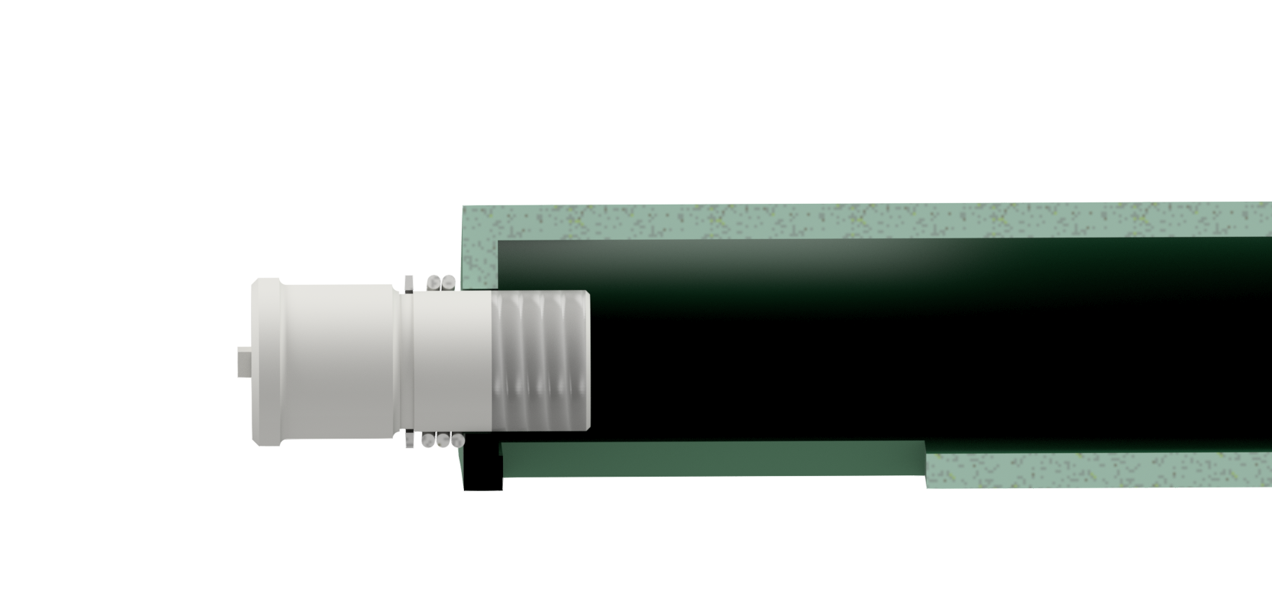
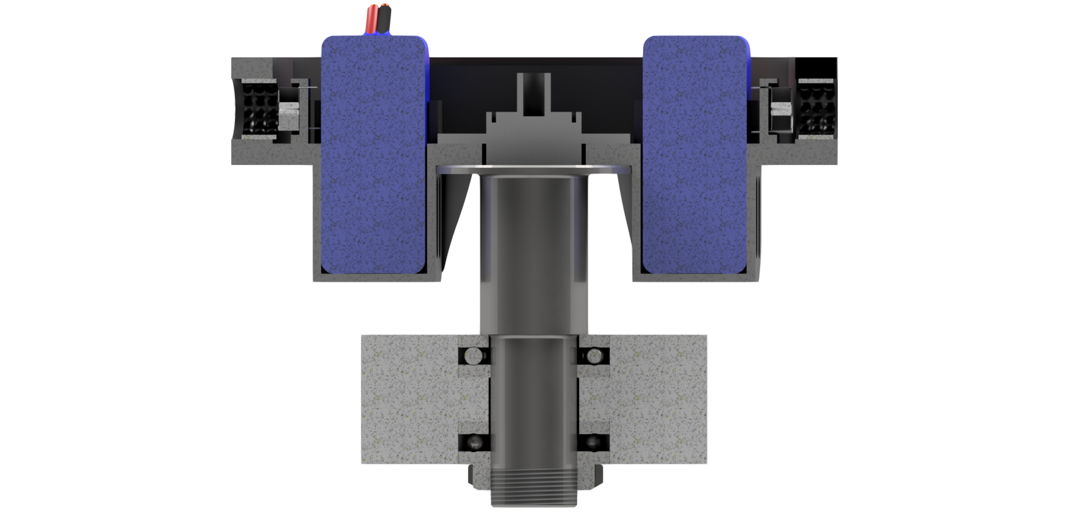
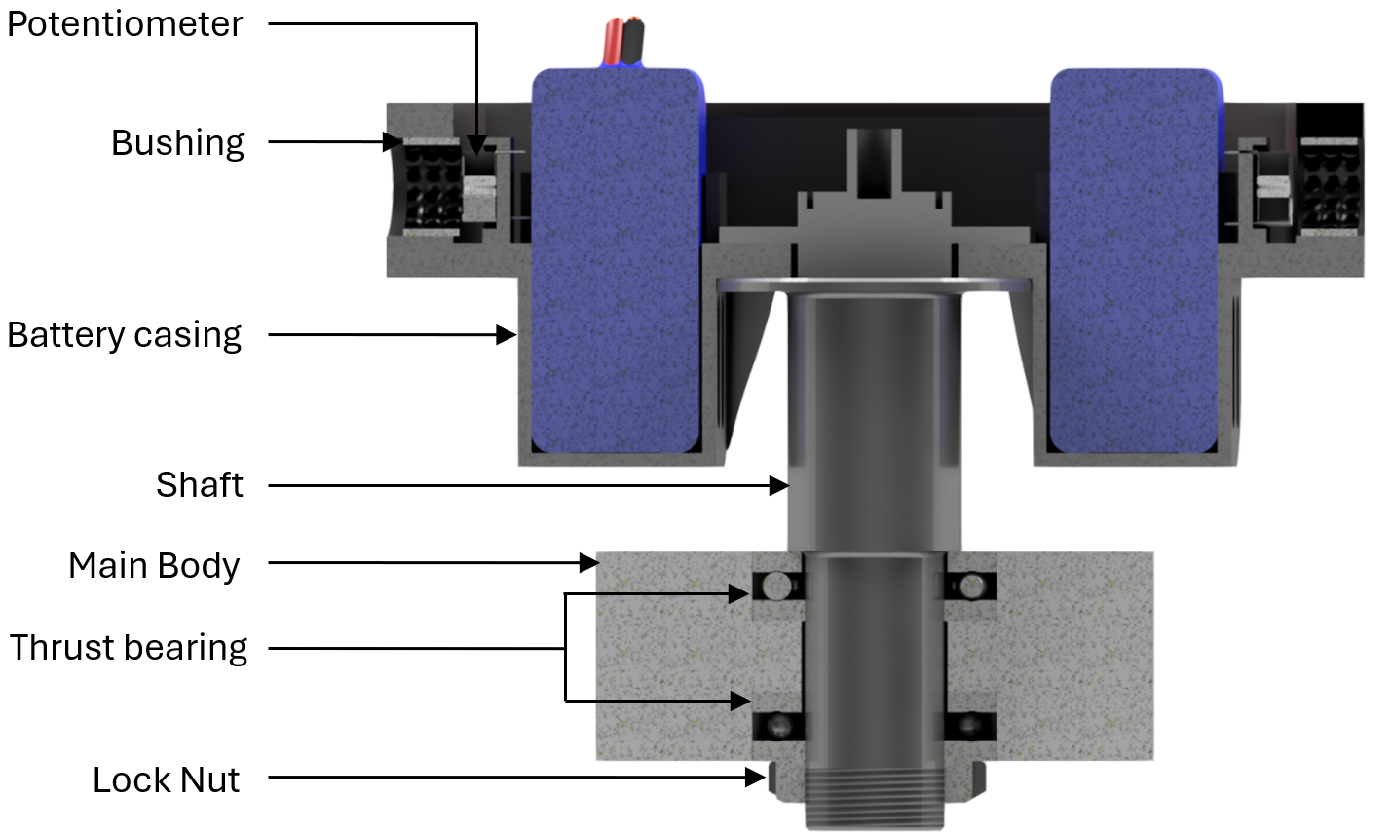
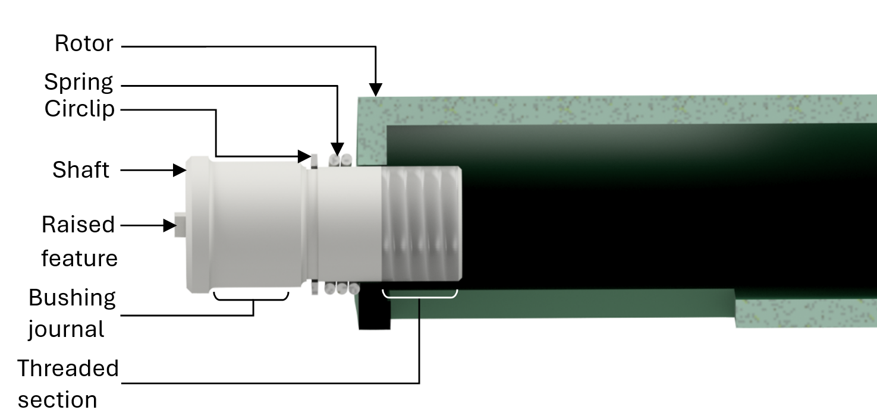
Design
Hub
Notes:
Using this a first prototype was created.
slip ring to transfer data from the microcontroller to the speed controllers

Slide 12
Design
Hub
Shaft fixed in rotor
Notes:
The hub is connected to the main body through a shaft and with 2 thrust bearings, located by a shoulder and locknut on the shaft
Frictionless bushing

Slide 13
Design
Rotor
Shaft fixed in rotor
Notes:
The rotor will have a shaft that runs through the whole blade and is kept in place with a circlip

Slide 14
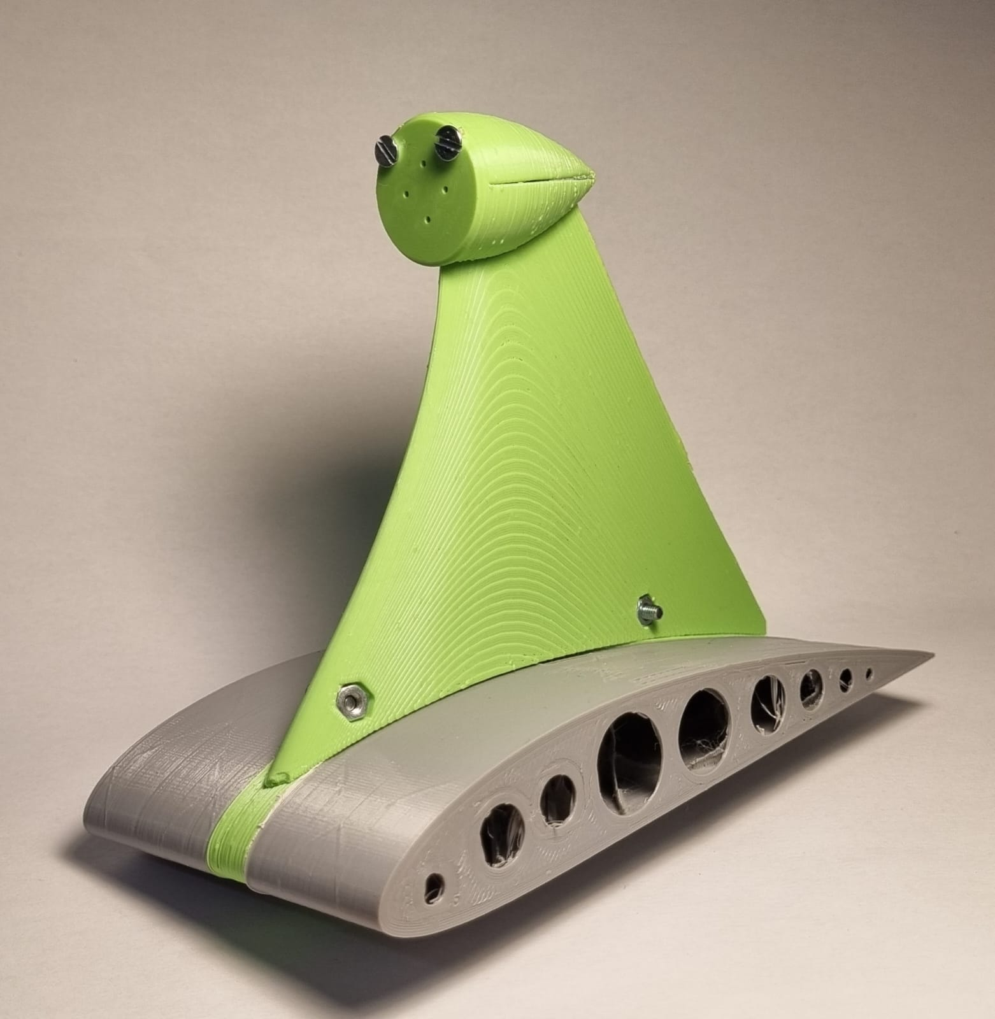
Roadmap
Future Development
Print the model
Finalize the CAD model and manufacture the shafts
Program the microcontroller
Caution while working with high current
Testing
Prototype placed on the test bench with 4 load cells, one on each corner
Record the amount of thrust measured by each load cell
Testing will be conducted in the structured lab
Special care needs to be taken with the large spinning rotor
Notes:
Going forward
be finalized and but others can start being printed and the shafts sent to the workshop
Working with electricity, high amps, switch off before while building/ not in use
Testing
Directional thrust will be applied, to see if it has different readings
The load cell’s data will be examined to see if directional thrust was achieved
During the test, due to the large spinning root could cause harm or parts can break off, and cation should be taken . Ensure the path is cleared

Slide 15
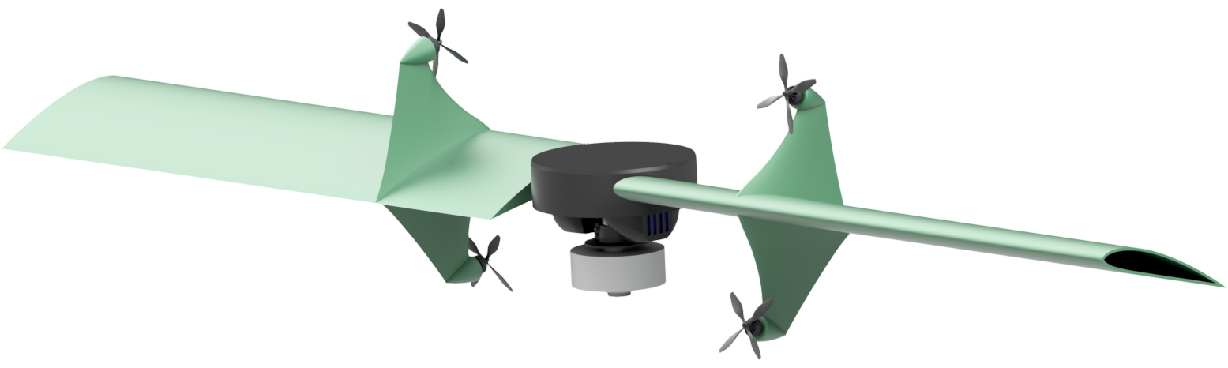
Summary
Created a mathematical model
Determine the rotor length and angular velocity
Determined optimal Tip thrust position
Further control system
Component selection
Design first initial design which is being finalized and printed
Notes:
In summary, for the past 6 months

Slide 16
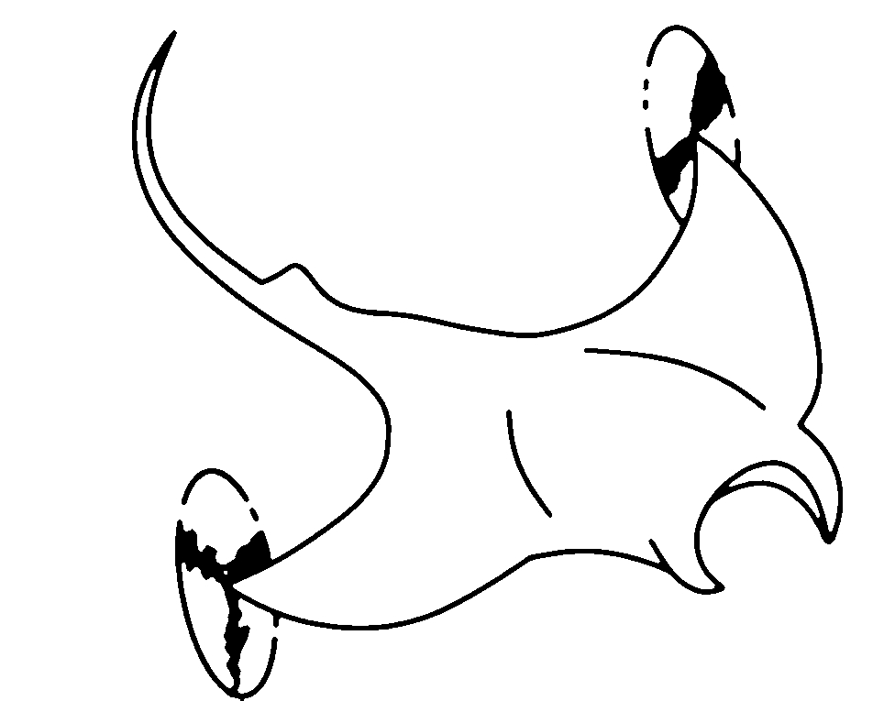
Thank you
Questions

Slide 17
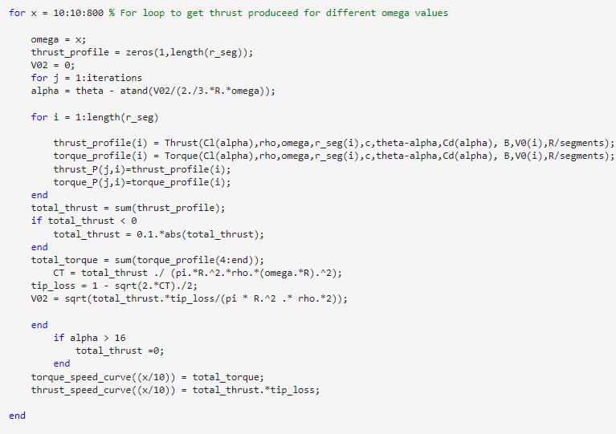
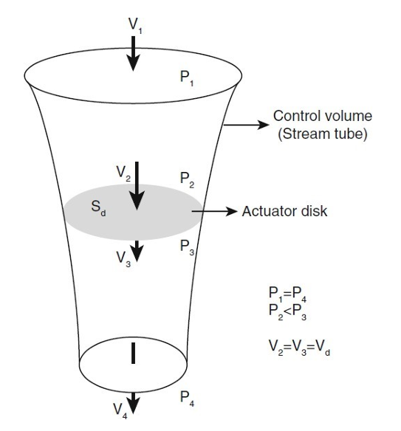
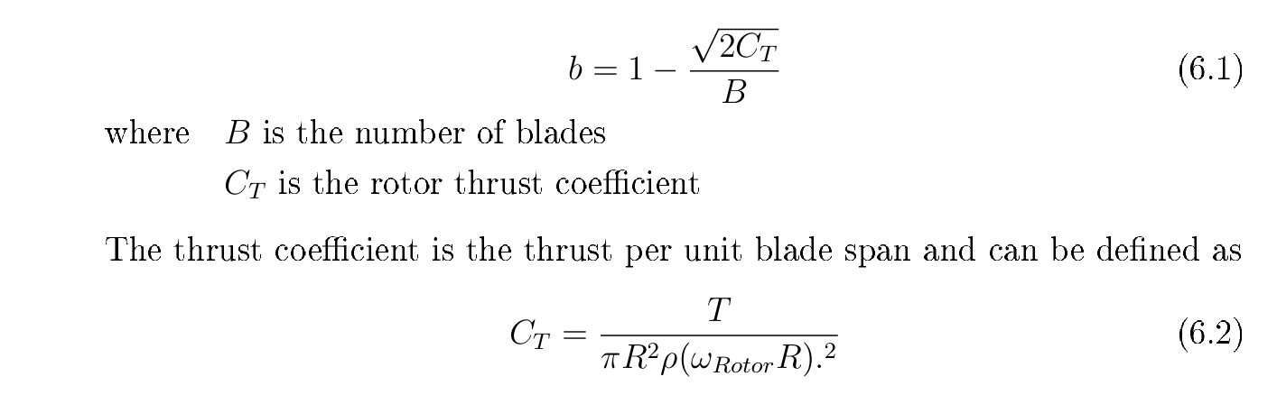
MATLAB Code
Blade element analysis

Slide 18
Budget
Item | Supplier | Price per unit | Quantity | Unit | Shipping | Category | Status | Total
HKD NRF24L01+ TRANSCEIVER MODULE | Communica | R 29.01 | 2 | items | R 99.87 | Electronics | Received | R 157.88
30a Electronic Speed Control Brushless | Takealot | R 230.00 | 4 | items | R - | Electroncis | Received | R 920.00
Flash 1303.5 5500kv Brushless Motor | FPV Fanatics | R 285.00 | 4 | items | R 80.00 | Electroncis | Quote sent | R 1,220.00
LOCK NUT 20X32X6MM M20X1.0 THREAD BTC | BMG | R 24.92 | 1 | items | R 80.00 | Mechanical | Not ordered | R 104.92
BM0805FB-ISB (Bushing) | Bearings Online SA | R 8.00 | 4 | items | R 80.00 | Mechanical | Not ordered | R 112.00
51104-ISB Thrust bearing | Bearings Online SA | R 52.00 | 2 | items | R - | Mechanical | Not ordered | R 104.00
HQ Durable Prop 2.9X2.9X4 Grey | Flying Robot | R 69.00 | 1 | set | R 80.00 | Mechanical | Not ordered | R 149.00
11.1v 1100mAh LiPo 25-30C (3 cell) | Battery Experts | R 600.00 | 1 | items | R 80.00 | Electronics | Not ordered | R 680.00
Hall effect | Micro Robotics | R 13.80 | 1 | packet (4) | R - | Electronics | Not ordered | R 13.80
Magnets |  | R 170.00 | 1 |  | R - | Mechanical | Not ordered | R 170.00
Black Bill |  | R 110.00 | 1 |  |  | Electronics | Not ordered | R 110.00
3D Printing |  |  |  |  |  |  | Not ordered | R -
Workshop |  |  |  |  |  |  | Not ordered | R -
 |  |  |  |  |  |  | Not ordered | R -
Current total: |  |  |  |  | R 179.87 |  |  | R 2,297.88
Predicted total: |  |  |  |  |  |  |  | R 3,583.72

Slide 19
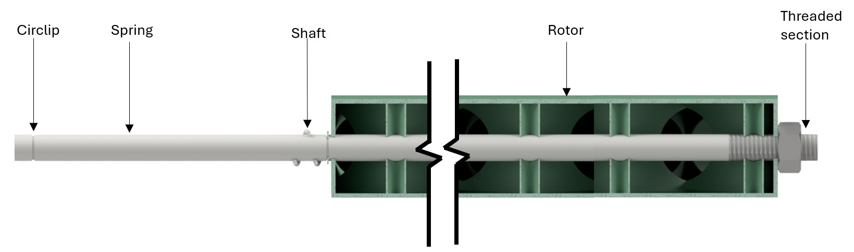
Redesigned Rotor

Slide 20
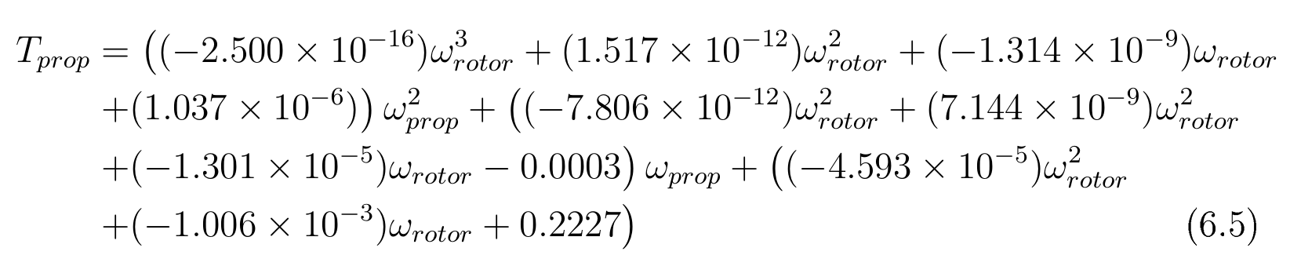
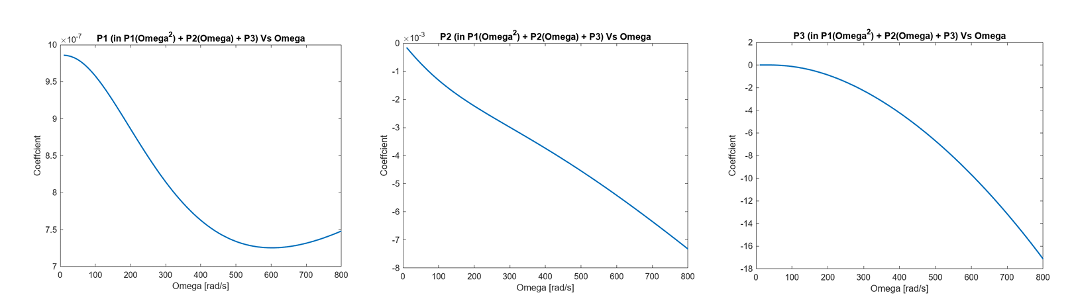

Slide 21
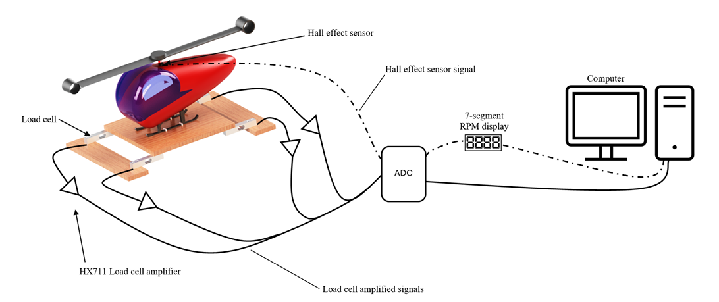
Experimental set up

Slide 22

Thank you
Enkosi
Dankie
Photo by Stefan Els
Notes:
Cover & End Slide Option
Replace the background image: Right-click on the slide, then choose Format Background and select Picture or texture fill. Select a new picture of your choice.
Remember to add an image attribution for e.g., Photo by Stefan Els.

